Slide 1
PROJECT TITLE
Review-3
Batch Number:CSE_144
Smart Curriculum Activity & Attendance App
Roll Number | Student Name
20221CSE0559 | Sharanegouda Malipatil
20221CSE0582 | Bhagesh
20221CSE0593 | Kotesh N B
Under the Supervision of,
Ms Smita S.P (Assistant Professor)
School of Computer Science and Engineering
Presidency University
Name of the Program: B.Tech Computer Science And Engineering
Name of the HoD: Dr. Blessed Prince
Name of the Program Project Coordinator: Mr. Muthuraju V
Name of the School Project Coordinators: Dr. Sampath A K , Dr. Geetha A

Slide 2
Content
Problem Statement
Objectives
Background and Related work for title Selection
Analysis of Problem Statement
Innovation or Novel Contributions
Git-hub Link
Timeline of the Project
References

Slide 3
Problem Statement
Accessibility – Allows visitors to book tickets anytime, anywhere, including for people with disabilities.
Organization:Educational
Category (Hardware / Software / Both) : Software
Problem Description:
Many educational institutions still rely on manual or basic digital attendance systems that consume class time and are prone to errors. Teachers spend valuable instructional time marking attendance instead of teaching. At the same time, students often misuse free periods due to the lack of structured academic or career guidance. Existing systems do not integrate attendance, timetable management, and personal planning. This creates inefficiency in administration and reduced student productivity. A smart, integrated solution is required to automate attendance and guide students toward productive use of their academic time.

Slide 4
Objectives
To develop a smart attendance and curriculum activity application for educational institutions.
To automate attendance using digital methods and reduce manual effort, errors, and time consumption for teachers.
To help students utilize free periods in a productive and goal-oriented manner.
To generate a structured daily routine based on timetable and student goals.
To improve student engagement, discipline, and time management by promoting organized and consistent academic habits.
To provide an easy-to-use, reliable system that can be efficiently used by both students and faculty members.

Slide 5
Background and Related work for title Selection
The use of digital tools in education has increased rapidly, especially for attendance and timetable management. However, most existing systems focus only on attendance recording and lack features that support student productivity during free hours. Studies show that structured planning and guided activities improve learning outcomes and personal development. Current solutions do not combine attendance automation with personalized activity suggestions. This highlights the need for a smart application that integrates attendance tracking with curriculum-based activity planning, leading to the selection of the title Smart Curriculum Activity & Attendance App.

Slide 6
Analysis of Problem Statement
Current Issue: Many educational institutions still rely on manual or partially digital attendance systems, which are time-consuming and prone to human errors.
Student Impact: Students lose valuable classroom time during attendance marking and often misuse free periods due to the absence of structured academic guidance.
Faculty & Administrative Challenges: Teachers spend significant instructional time managing attendance records, while administrators face difficulties in maintaining accurate and consolidated data
Academic & Discipline Risk: Inaccurate attendance tracking and unproductive use of free time negatively affect student discipline, engagement, and overall academic performance.
Need for Change: A smart, integrated system is required to automate attendance, manage timetables, and guide students toward productive utilization of their academic time.
Goal: To improve teaching efficiency, enhance student productivity, ensure accurate attendance records, and provide real-time insights for faculty and institutions.

Slide 7
Analysis of Problem Statement (contd...)
Software Requirements:
Frontend: HTML, CSS, JavaScript
Backend: Node.js, Express.js
Database: MongoDB
IDE/Editor: Visual Studio Code / Sublime Text
Browser: Google Chrome
Hardware Requirements:
Laptop/Desktop Computer
Minimum 4 GB RAM
Internet Connection

Slide 8
Analysis of Problem Statement (contd...)
Existing attendance systems are mostly manual or semi-digital, causing delays and consuming valuable classroom time.
Manual attendance marking is prone to errors, proxy attendance, and inconsistent record maintenance.
Lack of an integrated system means attendance, timetable, and student planning are handled separately, reducing efficiency.
Students often misuse free periods due to the absence of structured academic or productivity guidance.
Manual and fragmented systems increase faculty workload and administrative effort.
Absence of analytics and reporting tools makes it difficult to monitor attendance trends, student engagement, and overall academic performance.

Slide 9
Innovation or Novel Contributions
Integrated System: Combines attendance automation and student productivity planning in a single platform, which existing systems treat separately.
Free-Period Activity Guidance: Provides structured, curriculum-based activity suggestions during free periods instead of leaving time unmanaged.
Smart Routine Generation: Uses timetable data to generate a daily academic routine automatically.
Real-Time Transparency: Enables students to view attendance status instantly, improving accountability and discipline.
Reduced Faculty Workload: Minimizes manual effort and classroom time spent on attendance.
Data-Driven Insights: Generates attendance and time-utilization analytics for better academic monitoring.

Slide 10
Github Link
https://github.com/Kotesh989/CSE_144-project

Slide 11
Phase1 Completion Update
Content
Project Progress: 20% completed
Major Achievement: Frontend development finished (HTML, CSS, JavaScript)
Milestone Reached: Phase 1 deliverables submitted successfully
On Track: Progress aligns with planned Gantt chart timeline
Phase 2 Preview:
Backend development (Node.js, Express.js)
Database setup (MongoDB)

Slide 12
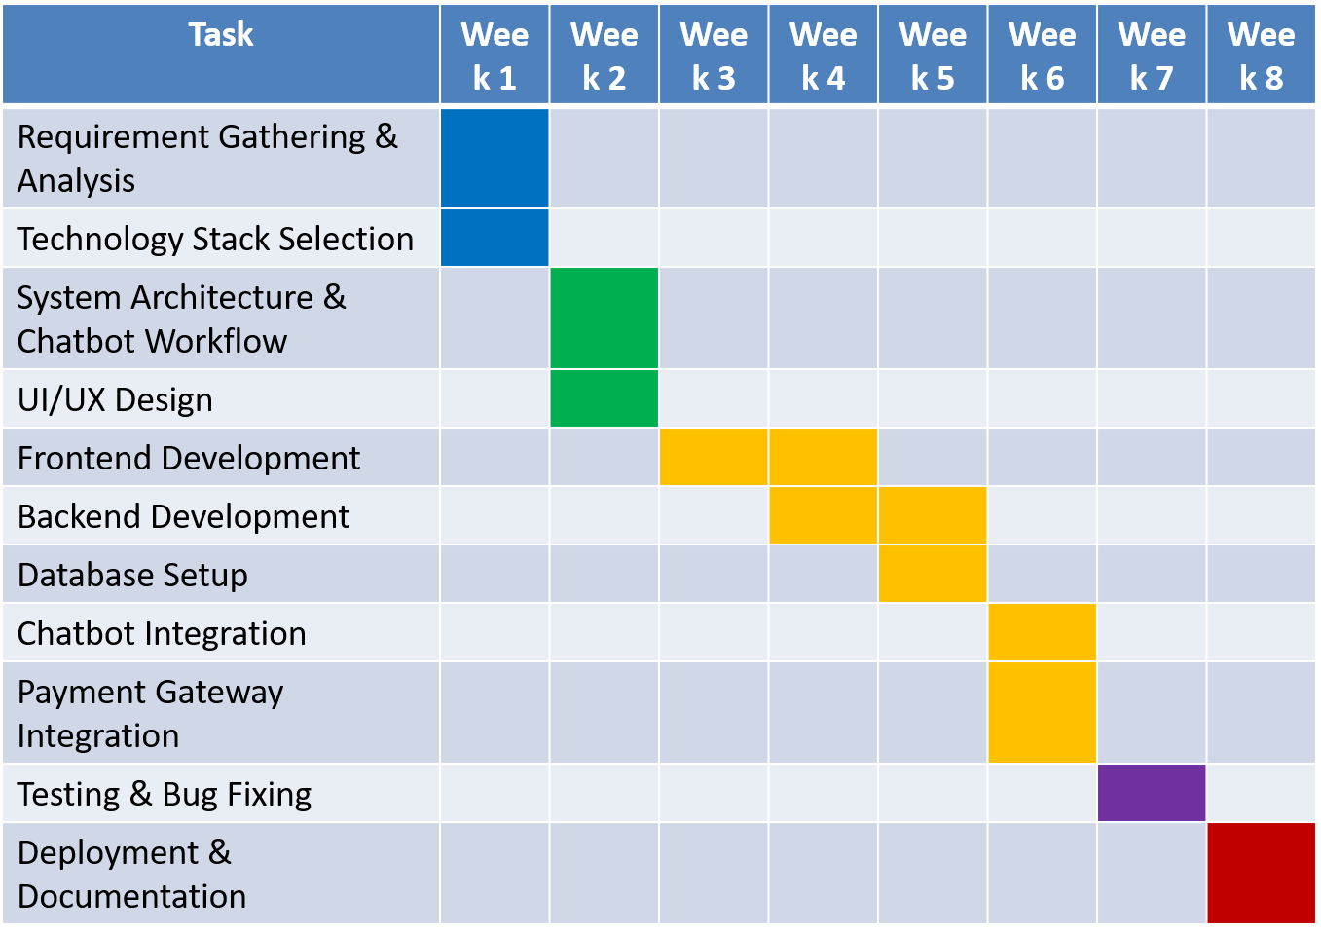
Timeline of the Project (Gantt Chart)
Phase1 Completed

Slide 13
References (IEEE Paper format)
[1] A. Patel and R. Shah, “Design and Development of a Mobile-Based Attendance Management System,” International Journal of Computer Applications (IJCA), vol. 174, no. 15, pp. 12–17, Apr. 2021.
[2] S. Kumar and P. Verma, “A Study on Student Time Management Using Smart Applications,” Journal of Emerging Technologies and Innovative Research (JETIR), vol. 7, no. 6, pp. 245–250, Jun. 2020.
[3] J. Li, Y. L. Theng, and S. Foo, “Effect of Mobile Applications on Learning and Student Productivity,” Journal of Medical Internet Research, vol. 18, no. 8, pp. 1–10, Aug. 2016.
[4] R. Singh and A. Kaur, “Web-Based Attendance Monitoring System Using Node.js and MongoDB,” International Journal of Advanced Research in Computer Science, vol. 11, no. 3, pp. 45–50, 2020.
[5] Ministry of Education, Government of India, National Education Policy 2020, New Delhi, India, 2020.

Slide 14


